Slide 1
From Hype to Fallout: Mapping Stakeholder Voices in the Theranos Scandal
Prakhar
Dr. Praveen Puram
Dr. Nakul Parameswar
Indian Institute of Technology Hyderabad (IITH)

Slide 2
Work is Conceptual and in Progress Constructive feedback is highly appreciated

Slide 3


Theranos Inc. and Elizabeth Holmes

Slide 4
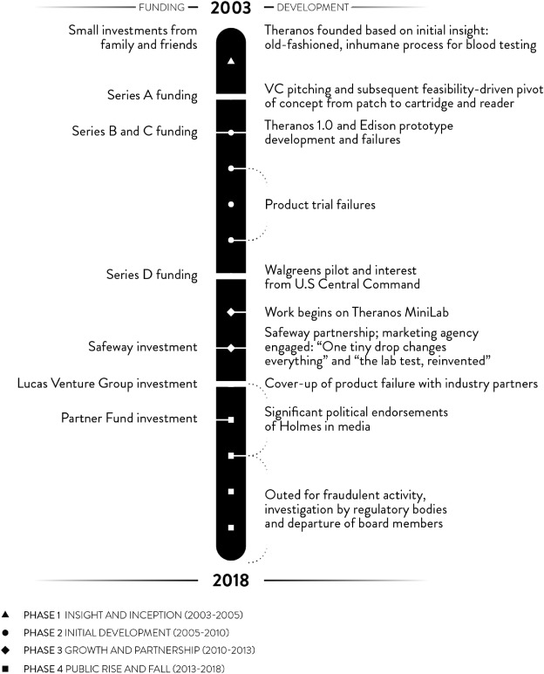
Scandal: From $9 billion to zero¹

Slide 5


Theranos Scandal in Popular Media

Slide 6
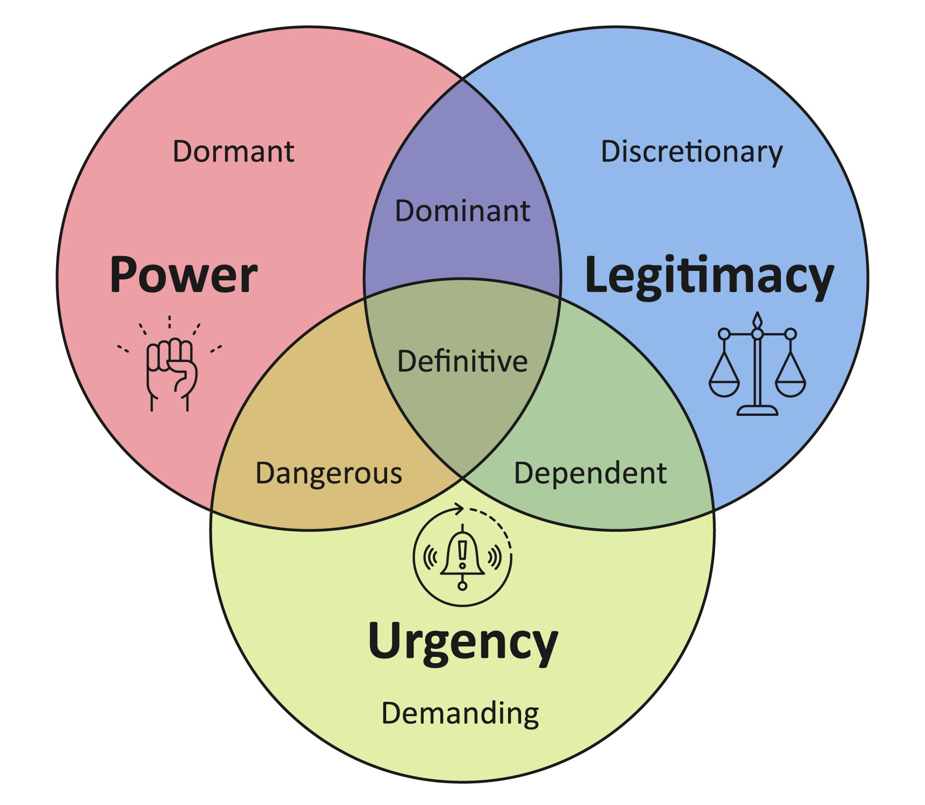
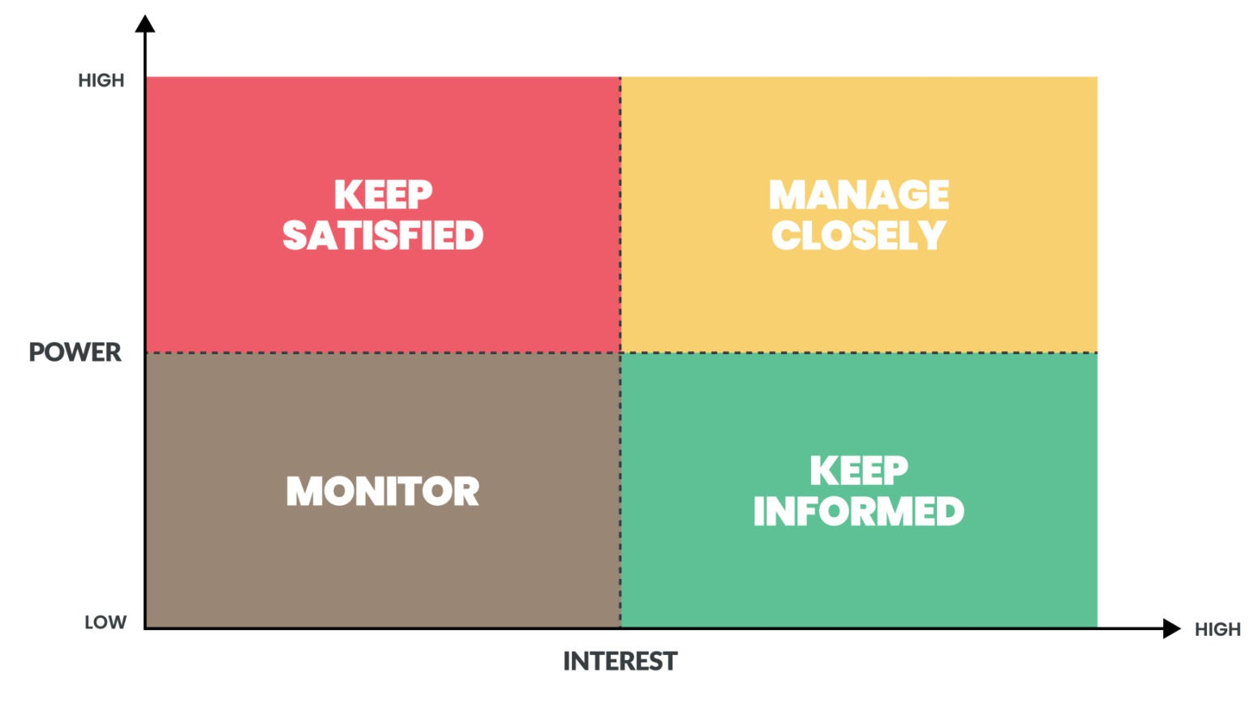
Popular Stakeholder frameworks
Stakeholder Salience Theory
Power-Interest Matrix

Slide 7
Affective Salience¹
Affective or emotional salience is the perceived importance of stimuli arising from emotional content (outrage, sympathy)
‘Emotional intensity’ and ‘Moral tone’ drive attention and judgement beyond technical evidence in high-velocity information environments
Low-power stakeholders (public, patients) gain influence via collective emotion 🡪 High-power stakeholders (investors, partners) adjust decisions in response to public affect

Slide 8
Affective Salience within Stakeholder theory
Traditional stakeholder salience: power, legitimacy, urgency.
Affective/Emotional salience
Another dimension that explains why stakeholders without formal power can meaningfully shape outcomes in scandals
Attention reallocation: public outrage elevates issue urgency and compels institutional responses (regulators, partners)
Legitimacy contests: emotional narratives redefine who is seen as credible (whistleblowers vs elite endorsers)
Temporal dynamics: emotions peak at exposure and adjudication stages, creating tipping points that accelerate cascade effects

Slide 9
Mechanisms in organizational judgement and decision-making
Signal amplification: Emotionally charged cues (patient harm, deception) dominate decision frames, reducing tolerance for uncertainty
Heuristic substitution: Under time pressure, affect-laden narratives serve as shortcuts, displacing technical validation and increasing the likelihood of sharp reversals
Contagion effects: Emotional tone diffuses across stakeholder networks (media, social platforms), triggering coordinated exit or corrective actions

Slide 10
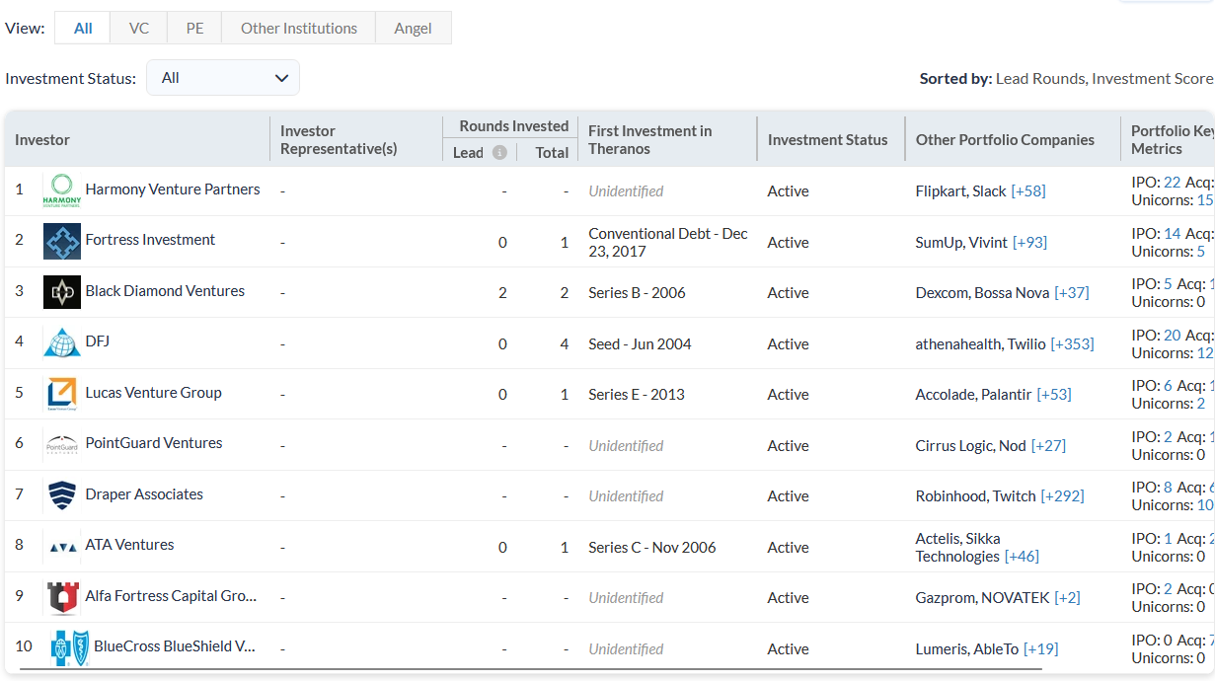
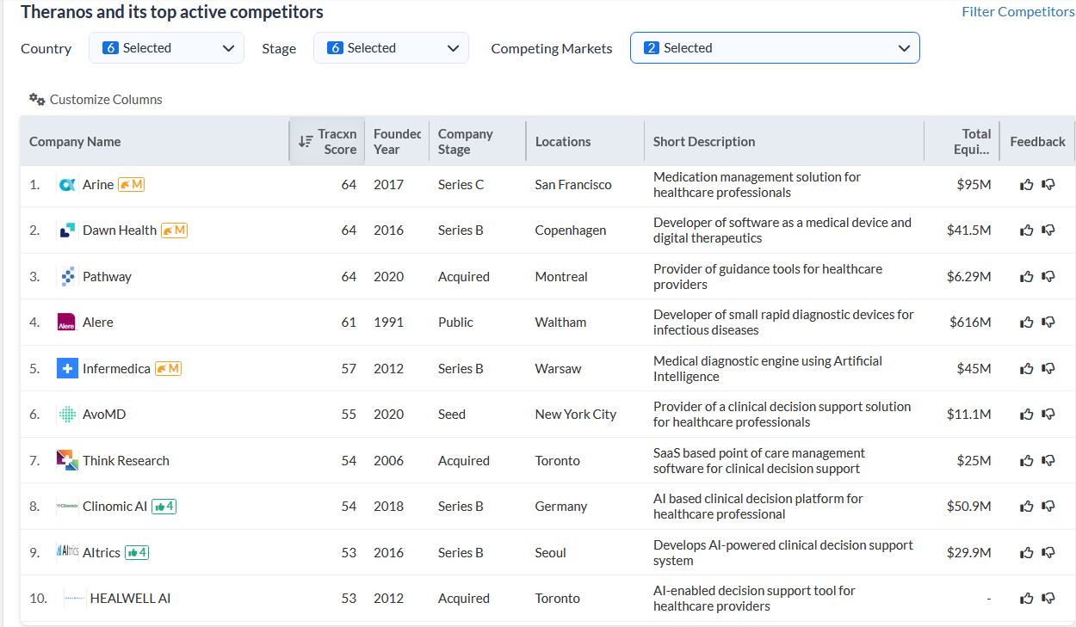
Data Collection (1 of 2)
Posts on Popular media and Instagram - Investors, Competitors (Set 1)

Slide 11
Data Collection (2 of 2)
Public comments/sentiments on ‘Theranos’ in Instagram from the following News Agencies (Set 2)
ABC News, BBC News, Bloomberg Business, Brut America,
Business Insider, CNBC, Guardian, Morning Brew, NBC News
News Max, New York Times, Wall Street Journal
Sheâ€™s still lying. She didnâ€™t make mistakes. She perpetuated a con.
She's a snake. Stop talking about her and stop covering her.
She's a villain (marvel category) and only gets 11 years? Unreasonable
So she will get like 4 years for good behavior ðŸ¤·ðŸ»â€â™‚ï¸
So weâ€™re supposed to feel sorry for her? Donâ€™t think soâ€¦.
So we're already supposed to forgive and feel bad for her?
Stop giving voices to people who don't deserve to be heard.
That damn karma bus ðŸšŒ has been making its stops lately.
Thatâ€™s what happens when you F people over!!!! No parole!!!! ðŸ¤®
The â€œdevoted motherâ€ is another one of her carefully concocted faÃ§ades.

Slide 12
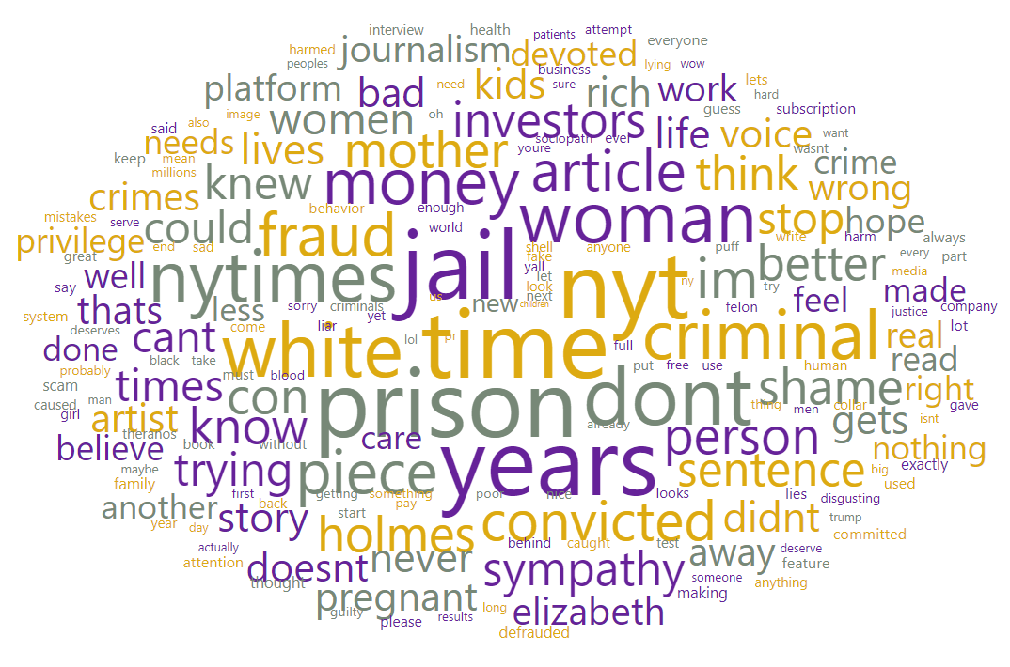
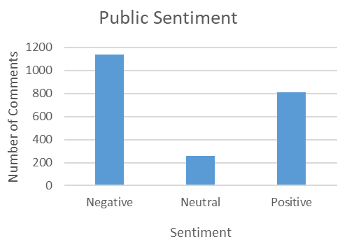
Text Preprocessing
Convert data to lowercase, Remove characters, Translation to English, Tokenization, Stopword removal
Total Cleaned comments = 2206
Sentiment analysis

Slide 13
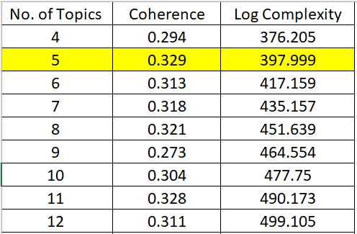
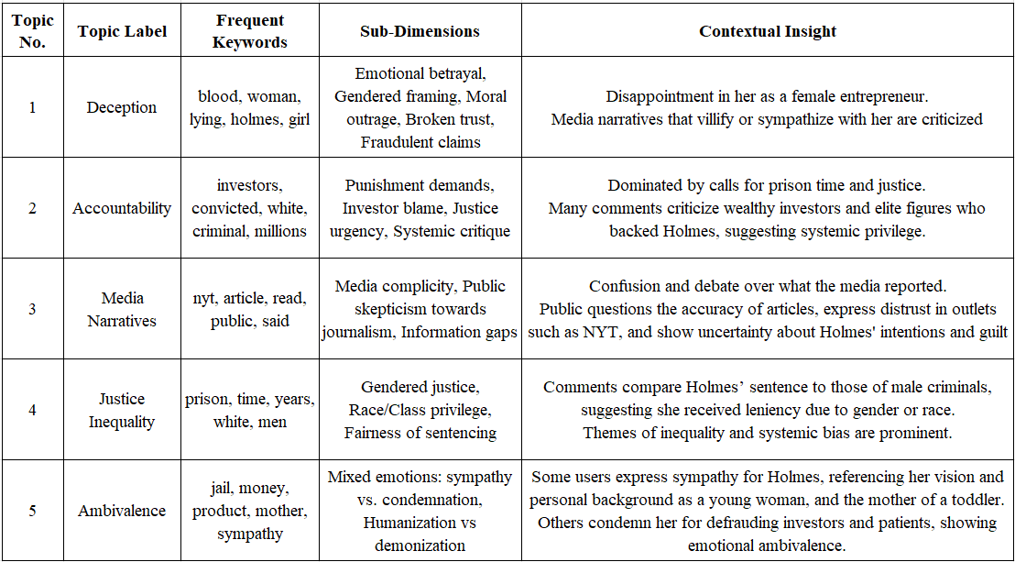
Topic Modelling (Latent Dirichlet Allocation)
Optimal Number of Topics = 5, by Highest Coherence value

Slide 14
Digital discourse as an affective infrastructure
Topic modelling reveals moral-emotional clusters – deception, accountability, justice inequality, ambivalence – which structure public meaning-making
Low-power influence: Aggregated emotion generates de facto urgency, compelling high-power actors to respond
Visibility and virality: Emotionally framed content enjoys attention advantages, accelerating narrative shifts and reputational trajectories
Narrative polarization: Competing frames (sympathy vs condemnation) produce unstable equilibria until institutional facts resolve ambiguity.

Slide 15
Managerial Implications (for regulators)
Evidence-led communications: Prioritize third-party validation and accessible performance data to counter emotion-driven narratives
Stakeholder monitoring: Track affective salience metrics (valence, moral terms, activation signals)
Whistleblower pathways: Institutionalize safe escalation and rapid remediation to prevent moral outrage from becoming the dominant narrative

Slide 16
Limitations
Only select sources were taken for data collection
Topic modelling results (topics) are not mutually exclusive (overlapping)
Qualitative Research is subjective
Only a single case was considered

Slide 17
Thank You

